Slide 1
Start with python
Session 2
AUG

Slide 2


Agenda
A
Strings
Tuples
Lists

Slide 3
What is a string?

Slide 4

String
A string in python is a sequence of characters.
It can be considered as an array or a list of characters.
It can be a word or a phrase (it can include spaces).
Quotes:
1) Single → print( ‘ Hello World ’ )
2) Double → print( “ Hello World ” )
3) Triple → ‘’’Multiple “”” Multiple # single line comment
line line
comment ‘’’ comment “””
H e l l o
‘Hello’ $≡$ “Hello”
or

Slide 5

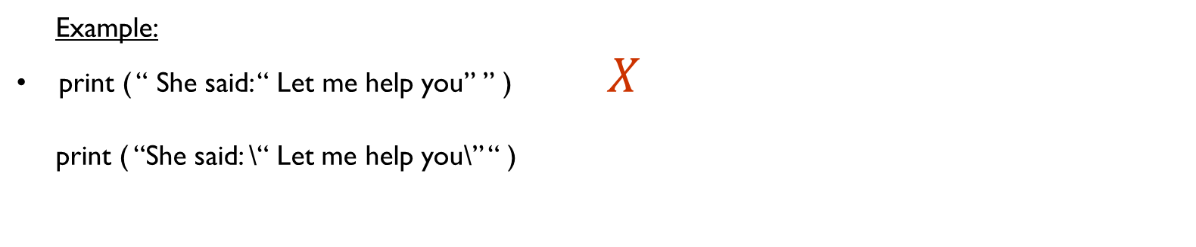
Escape characters ( \’ , \” , \\ , \n , \t )
\’ → Single quotes
\” → Double quotes
\n → newline
\t → Tab ( 4 to 5 spaces)
Example:
print ( “ She said: “ Let me help you” ” ) $X$
print ( “She said: \“ Let me help you\” “ )
Output
She said: “ Let me help you”

Slide 6
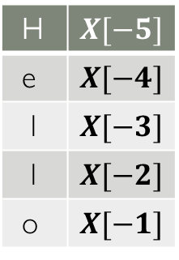
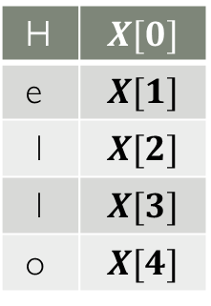
Indexing and Slicing
Indexing: Let : x = ‘Hello’
It’s used to access a single character.
0 1 2 3 4 . -5 -4 -3 -2 -1
H e l l o H e l l o
Ex: print ( x[0] )
>> H
Slicing: Let : x = ‘Hello’
It’s used to access a single character or a substring.
0 1 2 3 4 . -5 -4 -3 -2 -1
Ex:
1) print (x [ 1st index : 2nd index - 1 ] ) 2) print (x [ : ] )
print ( x [ 2: 4 ] ) >> Hello
>> ll # print the
whole string.
3) print (x [ 1st index : ] )
print ( x [ -3 : ] ) # from a specific index
>> llo till the end.
4) print (x [ : 2nd index - 1 ] )
print ( x [ : 4 ] ) # from the beginning
>> Hell till a specific index.
String_name[ Initial : End : IndexJump ]
H e l l o
H e l l o
H e l l o
H e l l o
H | $$X[0]$$
e | $$X[1]$$
l | $$X[2]$$
l | $$X[3]$$
o | $$X[4]$$
H | $$X[−5]$$
e | $$X[−4]$$
l | $$X[−3]$$
l | $$X[−2]$$
o | $$X[−1]$$

Slide 7
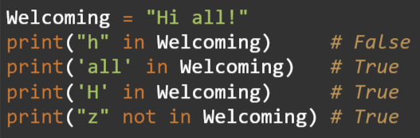
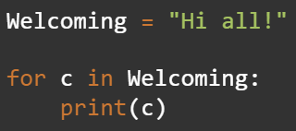
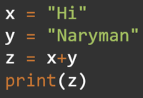
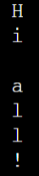
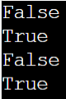
Errors
Ex: s = “Berry”
char = fruit[5]
2) s[0] = ‘h’
Strings are
immutable
In keyword Iterating through String
a String Concatenation
Output:
Output:
Output:

Slide 8
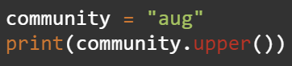
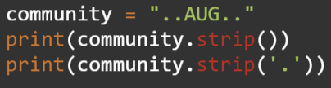
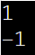
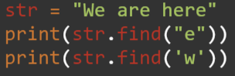
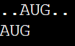
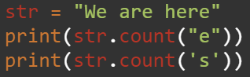
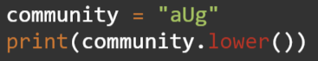
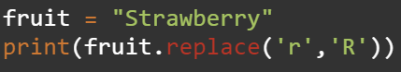
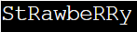
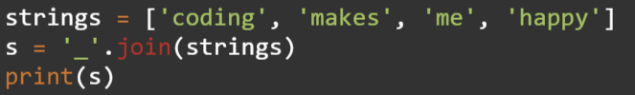
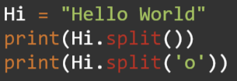
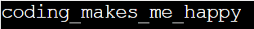
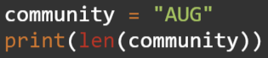
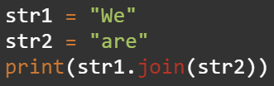
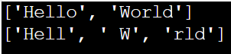
Important built-in functions
. upper( )
Output:
. lower( )
Output:
. len ( string )
Output: 3
. strip( )
Output:
. replace( arg1, arg2 )
Output:
. split( )
Output:
. find( string )
Output:
. count( string )
Output:
. join( list of strings )
Output:
Output: aWerWee
We will talk about it later in lists section.

Slide 9
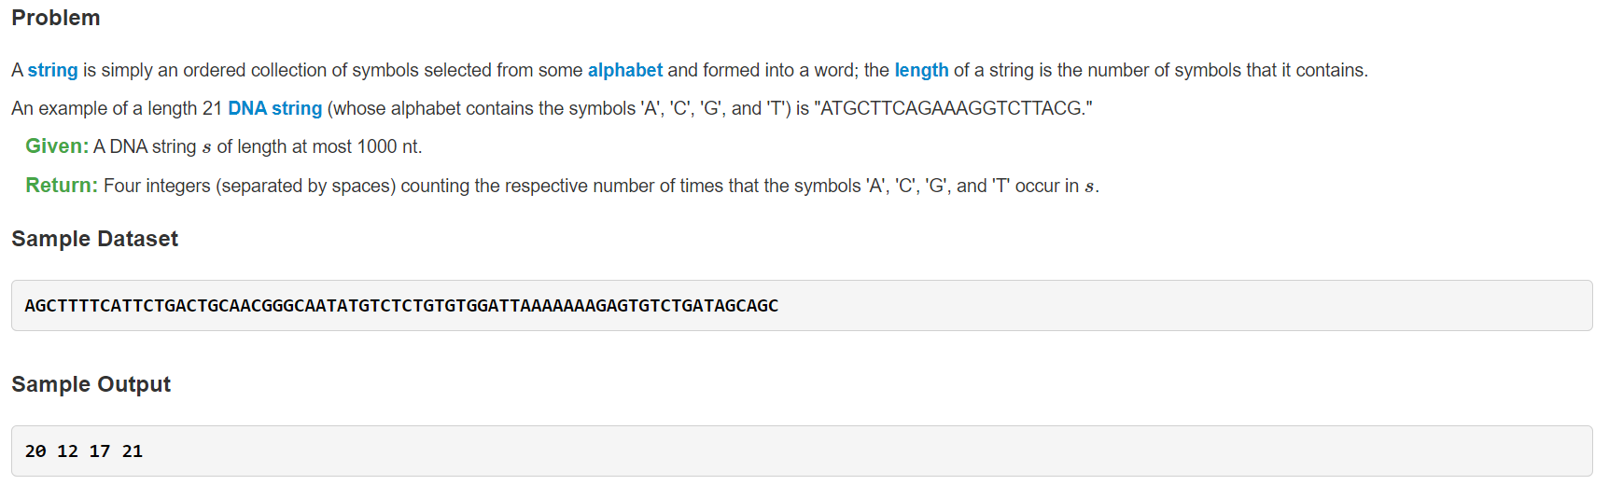
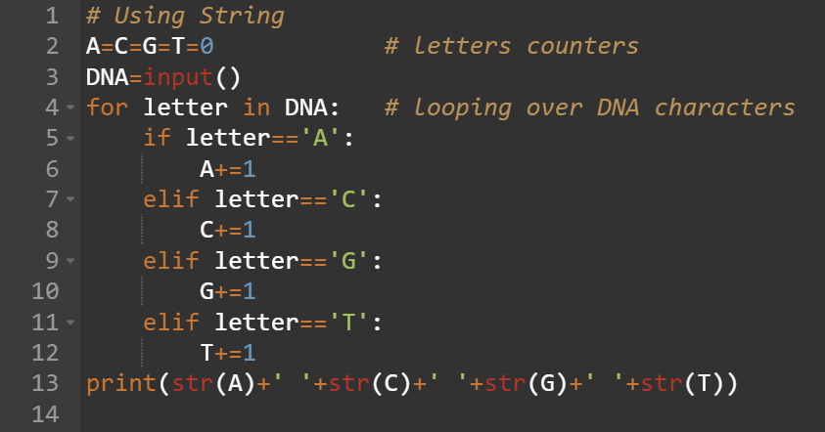
Task 1
Will we submit this code as it is on Rosalind?
No

Slide 10
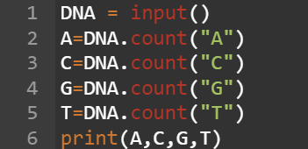
Task 1
Another solution

Slide 11
How to submit your answer on Rosalind?

Slide 12
Break
10 minutes break

Slide 13

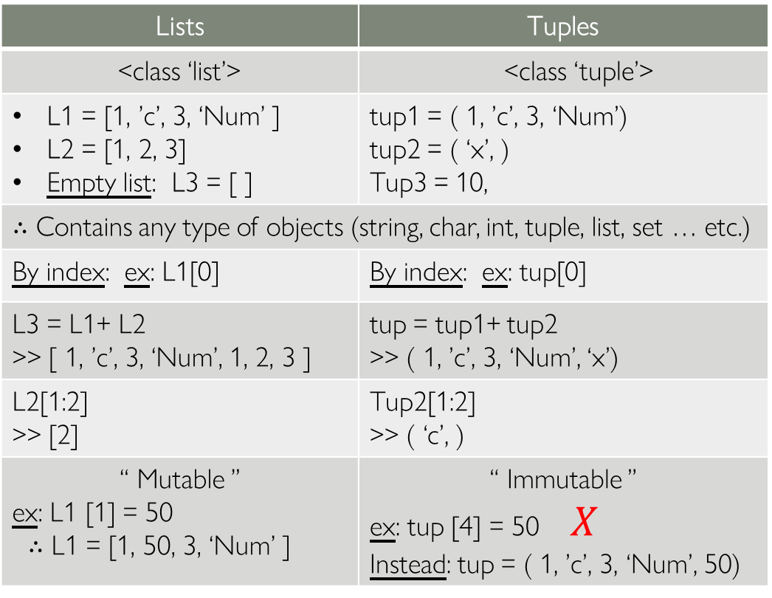
Lists vs Tuples
It’s preferred that the list elements are of the same data type
Lists | Tuples
<class ‘list’> | <class ‘tuple’>
L1 = [1, ’c’, 3, ‘Num’ ] L2 = [1, 2, 3] Empty list: L3 = [ ] | tup1 = ( 1, ’c’, 3, ‘Num’) tup2 = ( ‘x’, ) Tup3 = 10,
∴ Contains any type of objects (string, char, int, tuple, list, set … etc.) | ∴ Contains any type of objects (string, char, int, tuple, list, set … etc.)
By index: ex: L1[0] | By index: ex: tup[0]
L3 = L1+ L2 >> [ 1, ’c’, 3, ‘Num’, 1, 2, 3 ] | tup = tup1+ tup2 >> ( 1, ’c’, 3, ‘Num’, ‘x’)
L2[1:2] >> [2] | Tup2[1:2] >> ( ‘c’, )
“ Mutable ” ex: L1 [1] = 50 ∴ L1 = [1, 50, 3, ‘Num’ ] | “ Immutable ” ex: tup [4] = 50 $X$ Instead: tup = ( 1, ’c’, 3, ‘Num’, 50)
type ( ) :
Example :
Accessing there elements:
Concatenation:
Slicing:
Mutability:
The comma indicates it’s a tuple
Values of tuple can’t change once created.
You can only override the whole tuple.

Slide 14
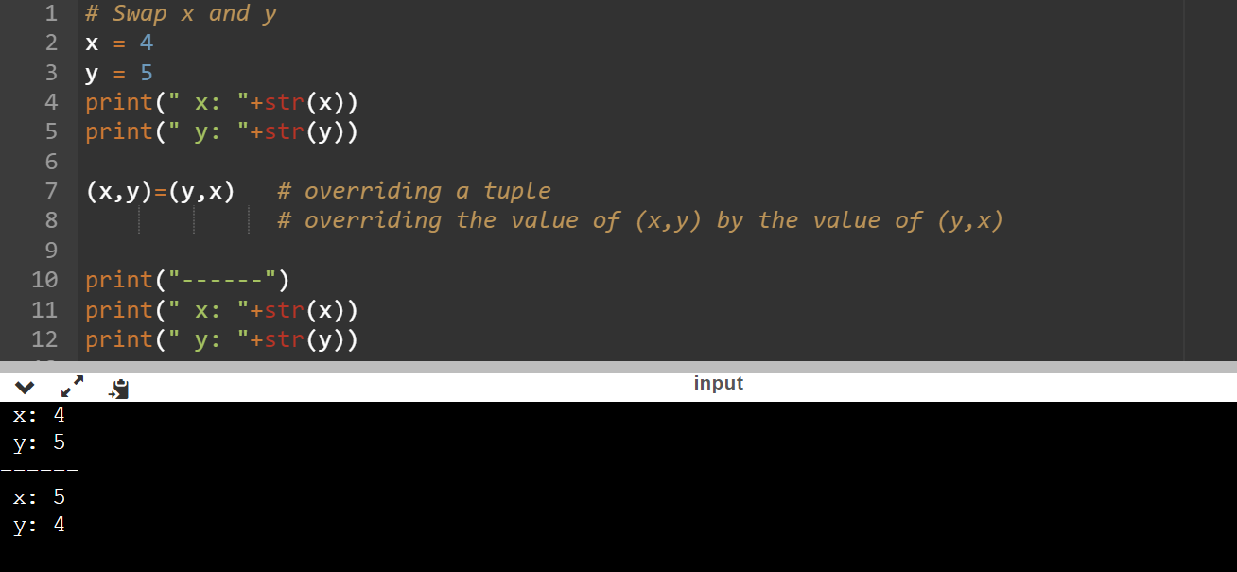
Task 2 “Tuples”
Example 1: You are given 2 numbers swap them using tuples:

Slide 15
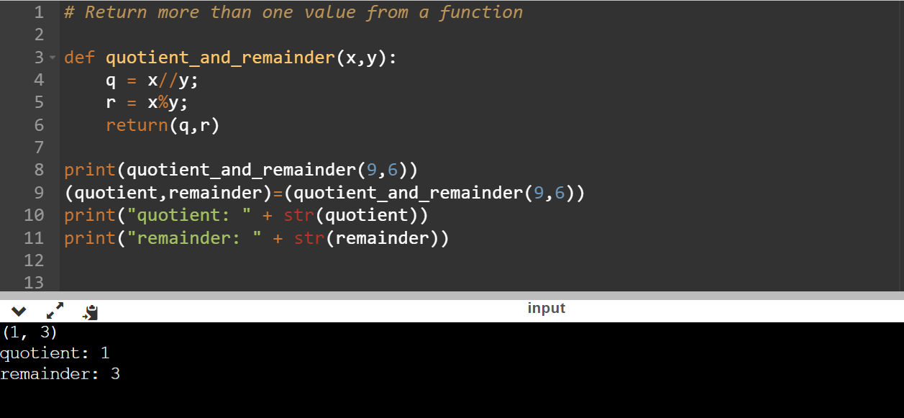
Task 3 “Tuples”
Example 2: “Return more than one value from a function”
You will be given two variables x and y, return:
1) quotient
2) remainder

Slide 16
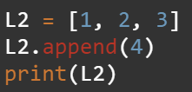
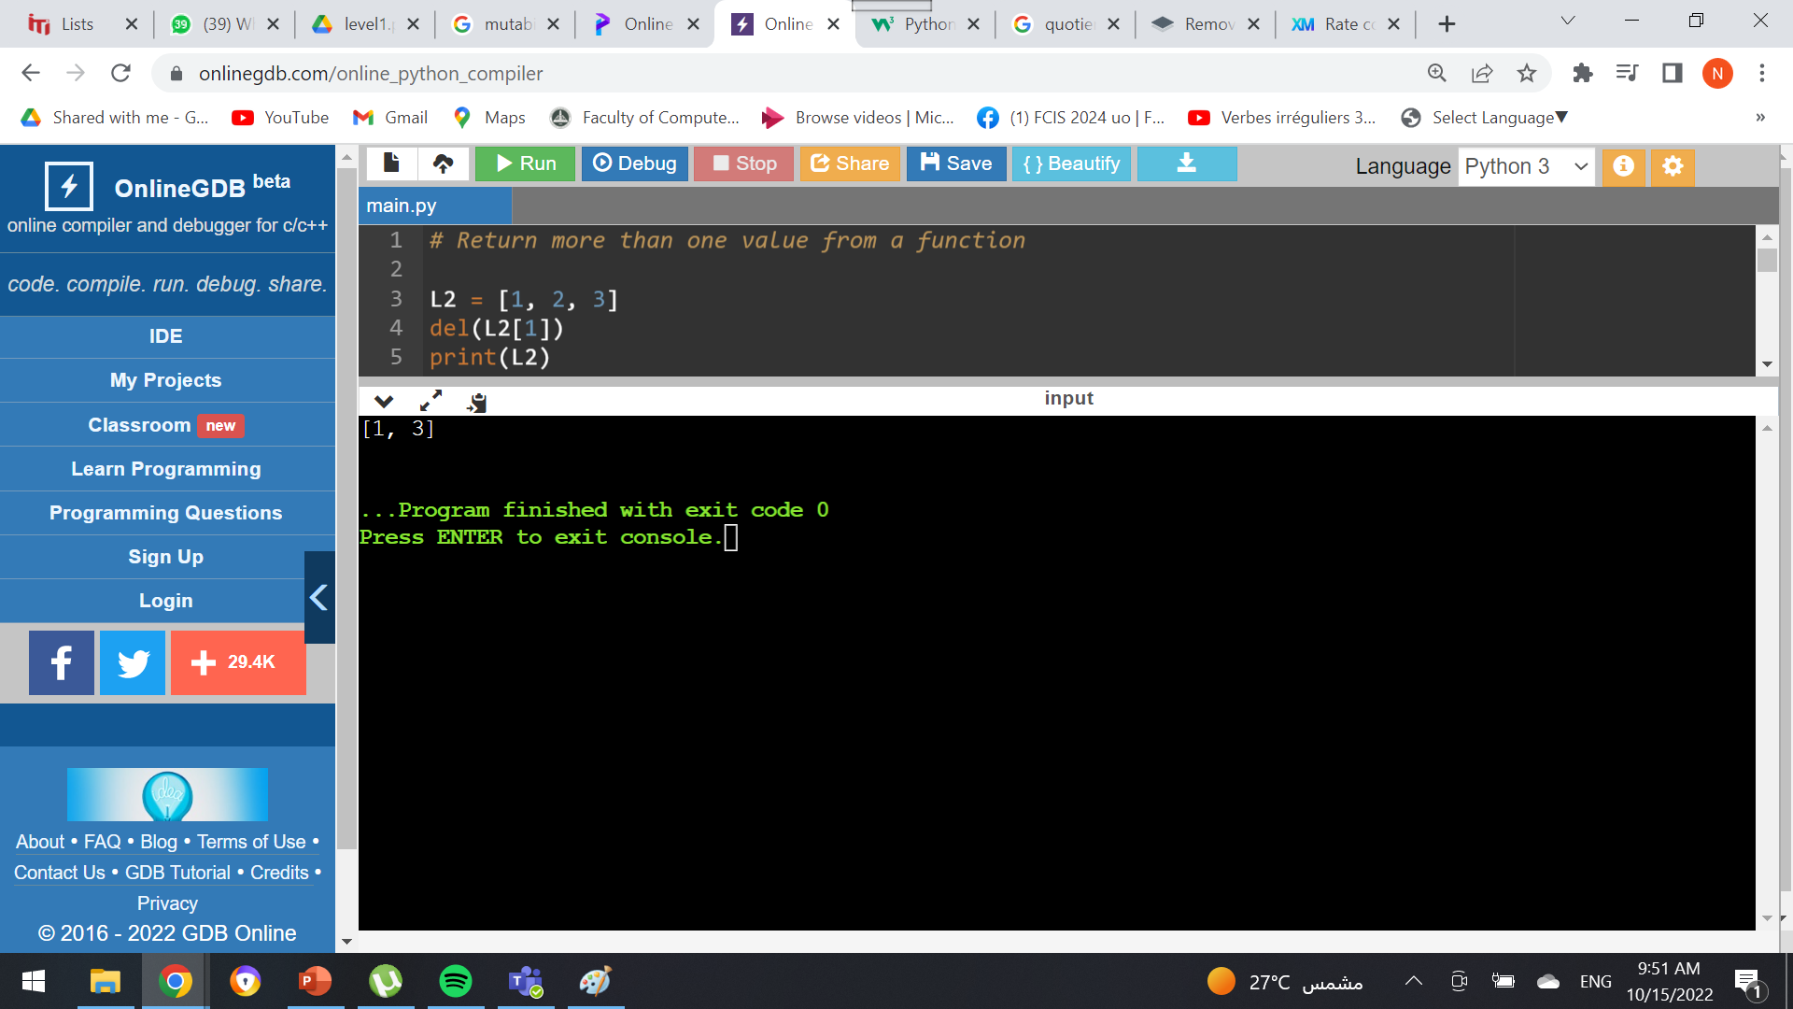
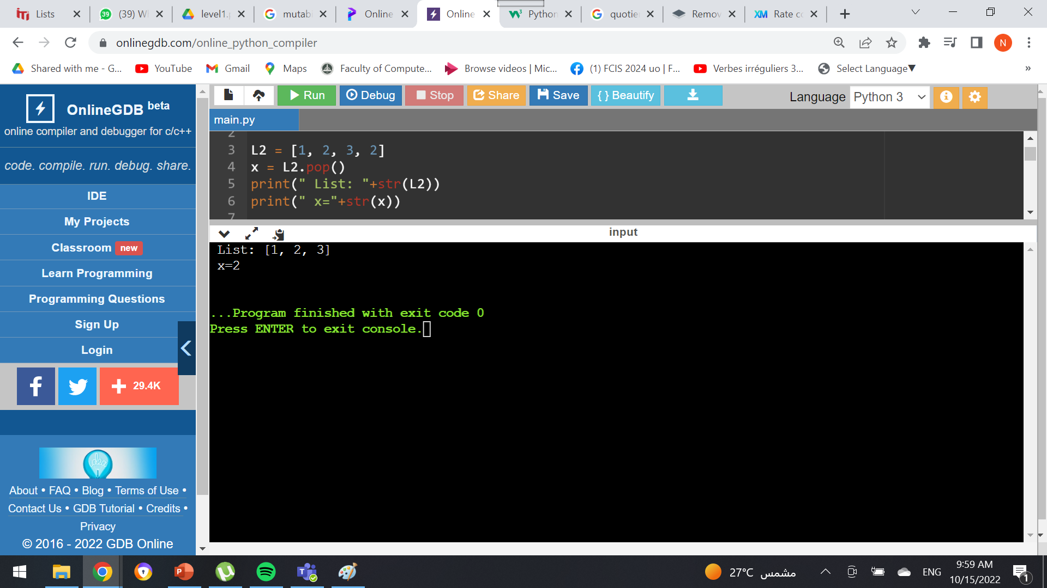
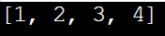
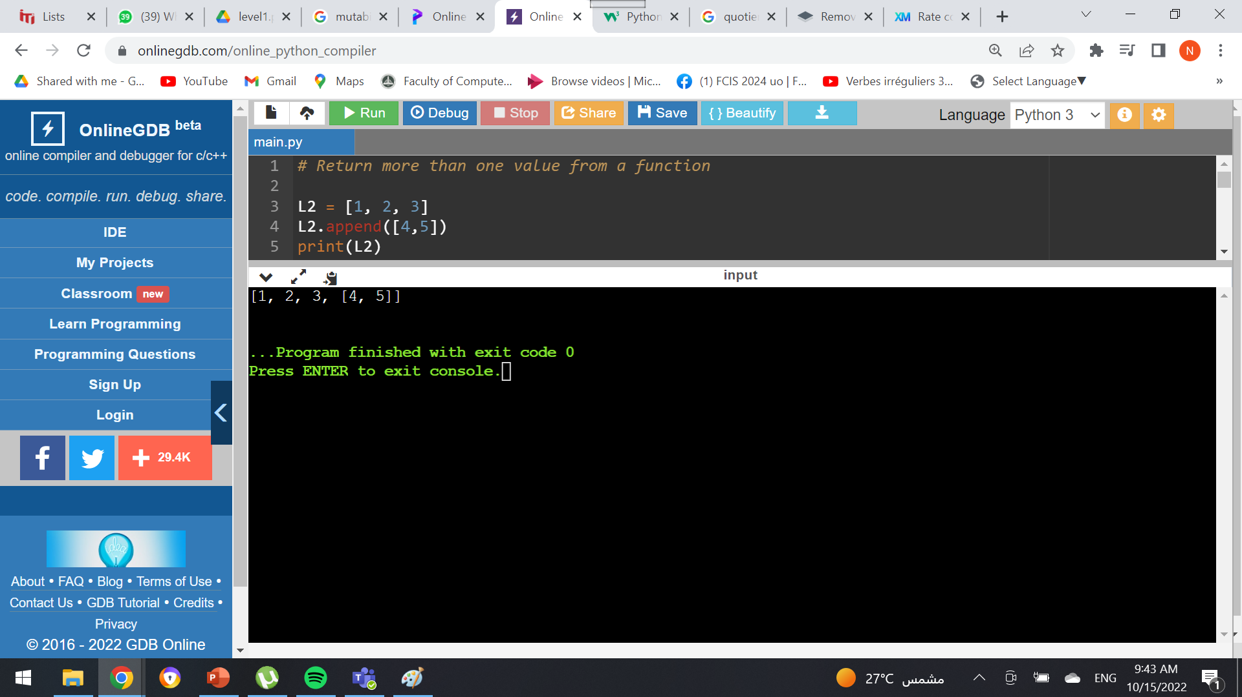
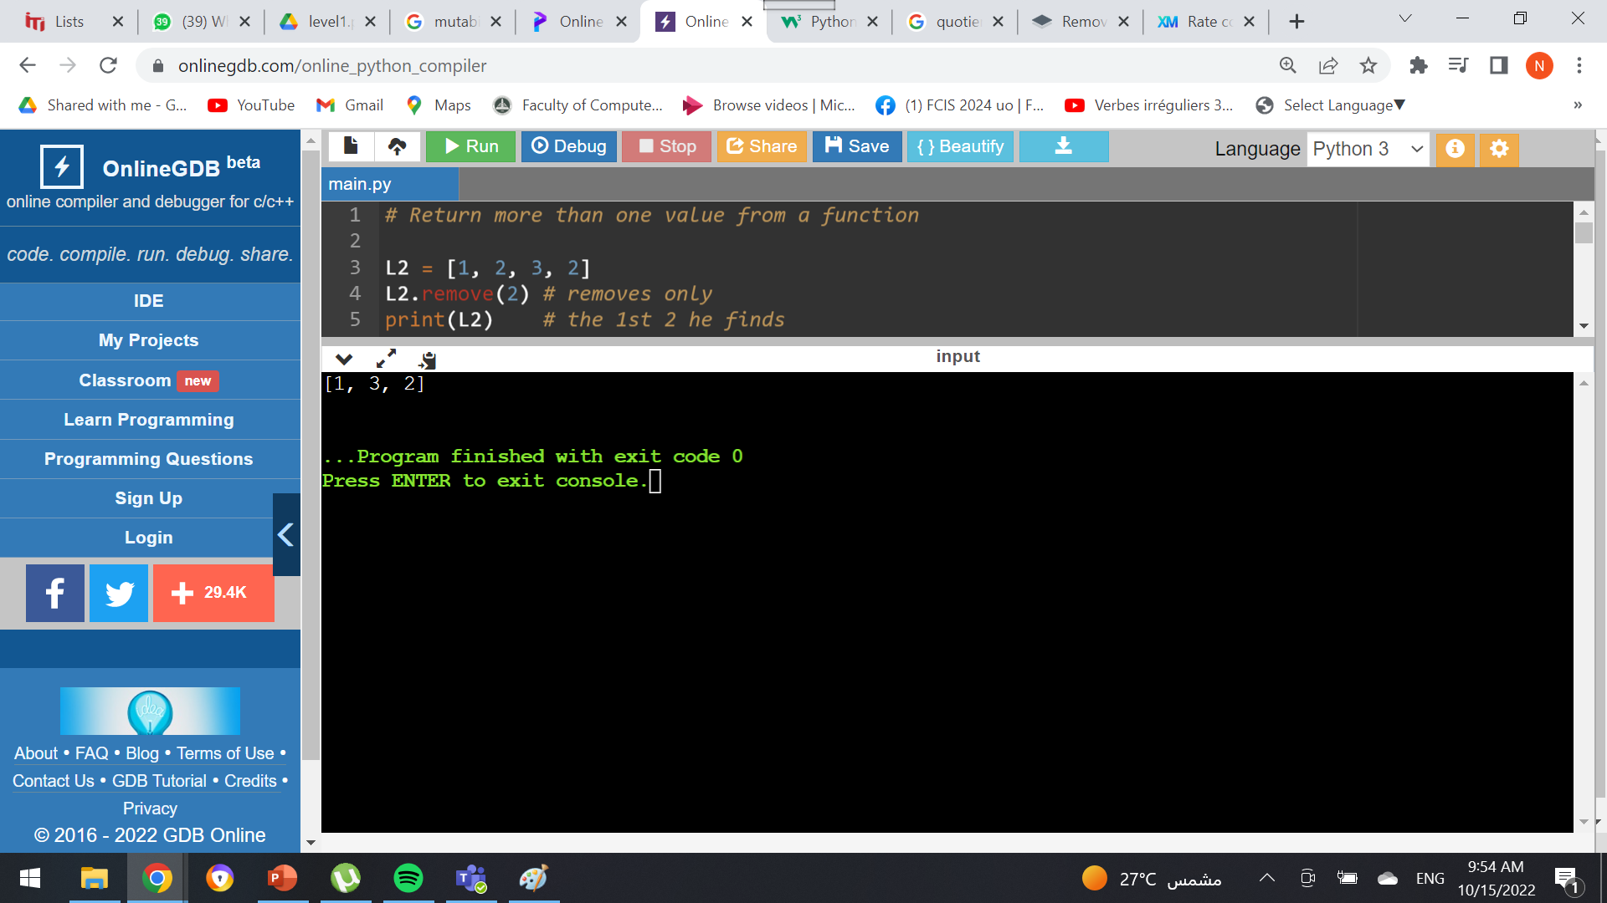
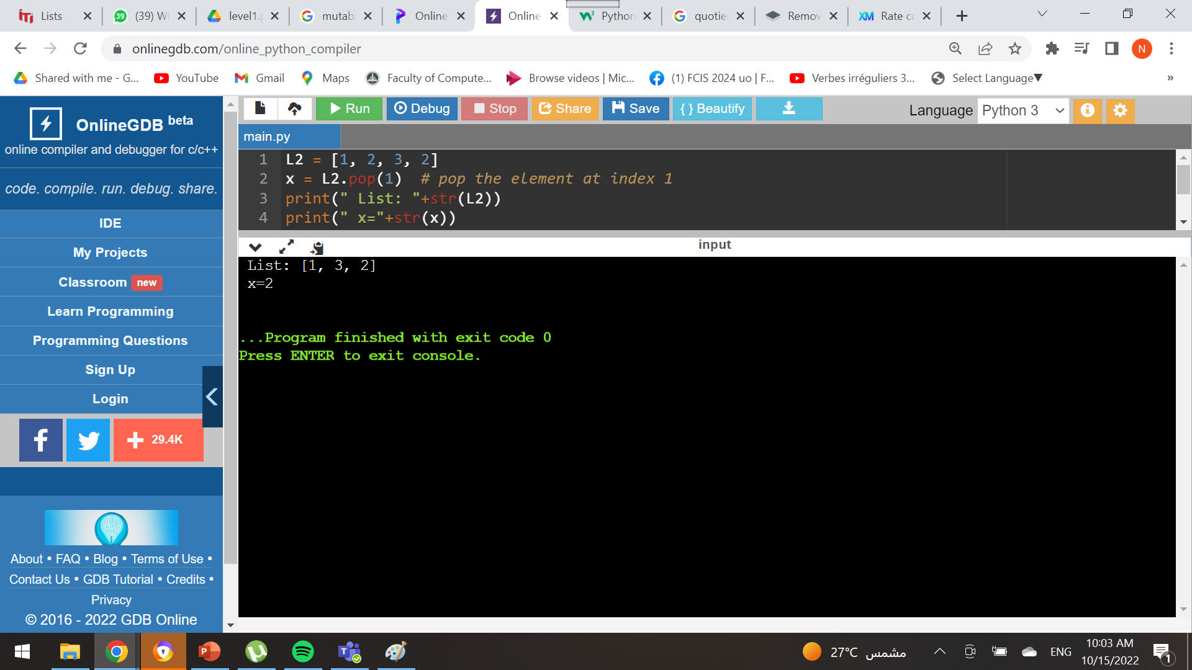

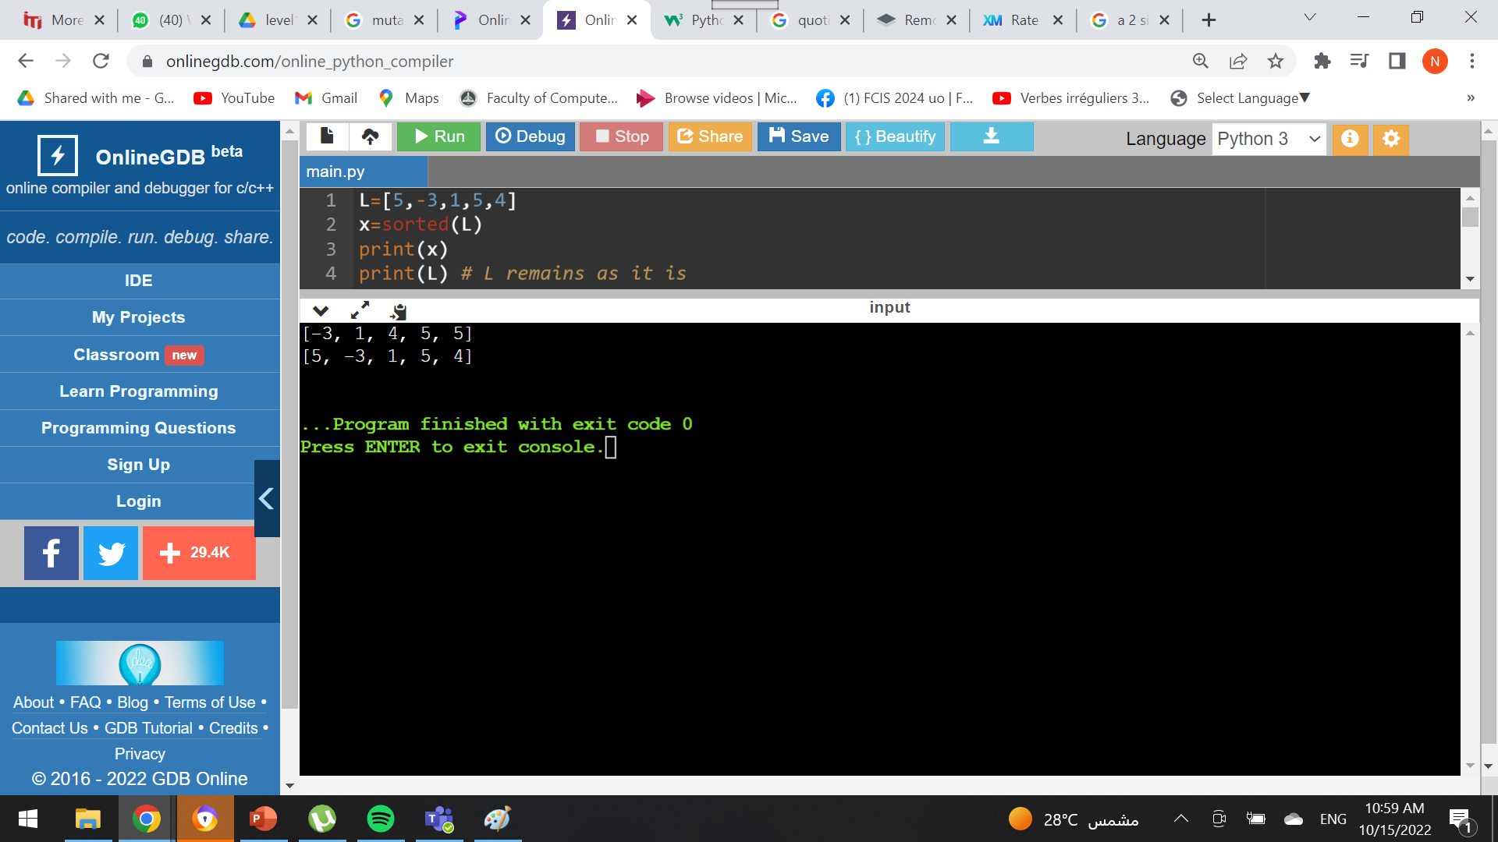

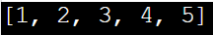
Some list functions
. append( x )
vs
. extend(list)
. pop ( )
vs
. pop(index)
del( L[index] )
vs
. remove(value)
. pop( )
Output:
Output:
. append( x )
Output:
Output:
. extend(list)
Output:
del( L [index] )
Output:
. remove(value)
Output:
sorted ( )
vs
. sort ( )
sorted(L)
Output:
.sort ( )
. reverse ( )

Slide 17

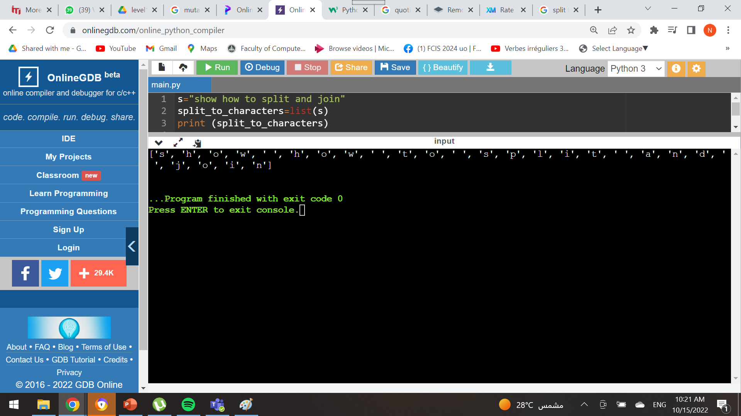
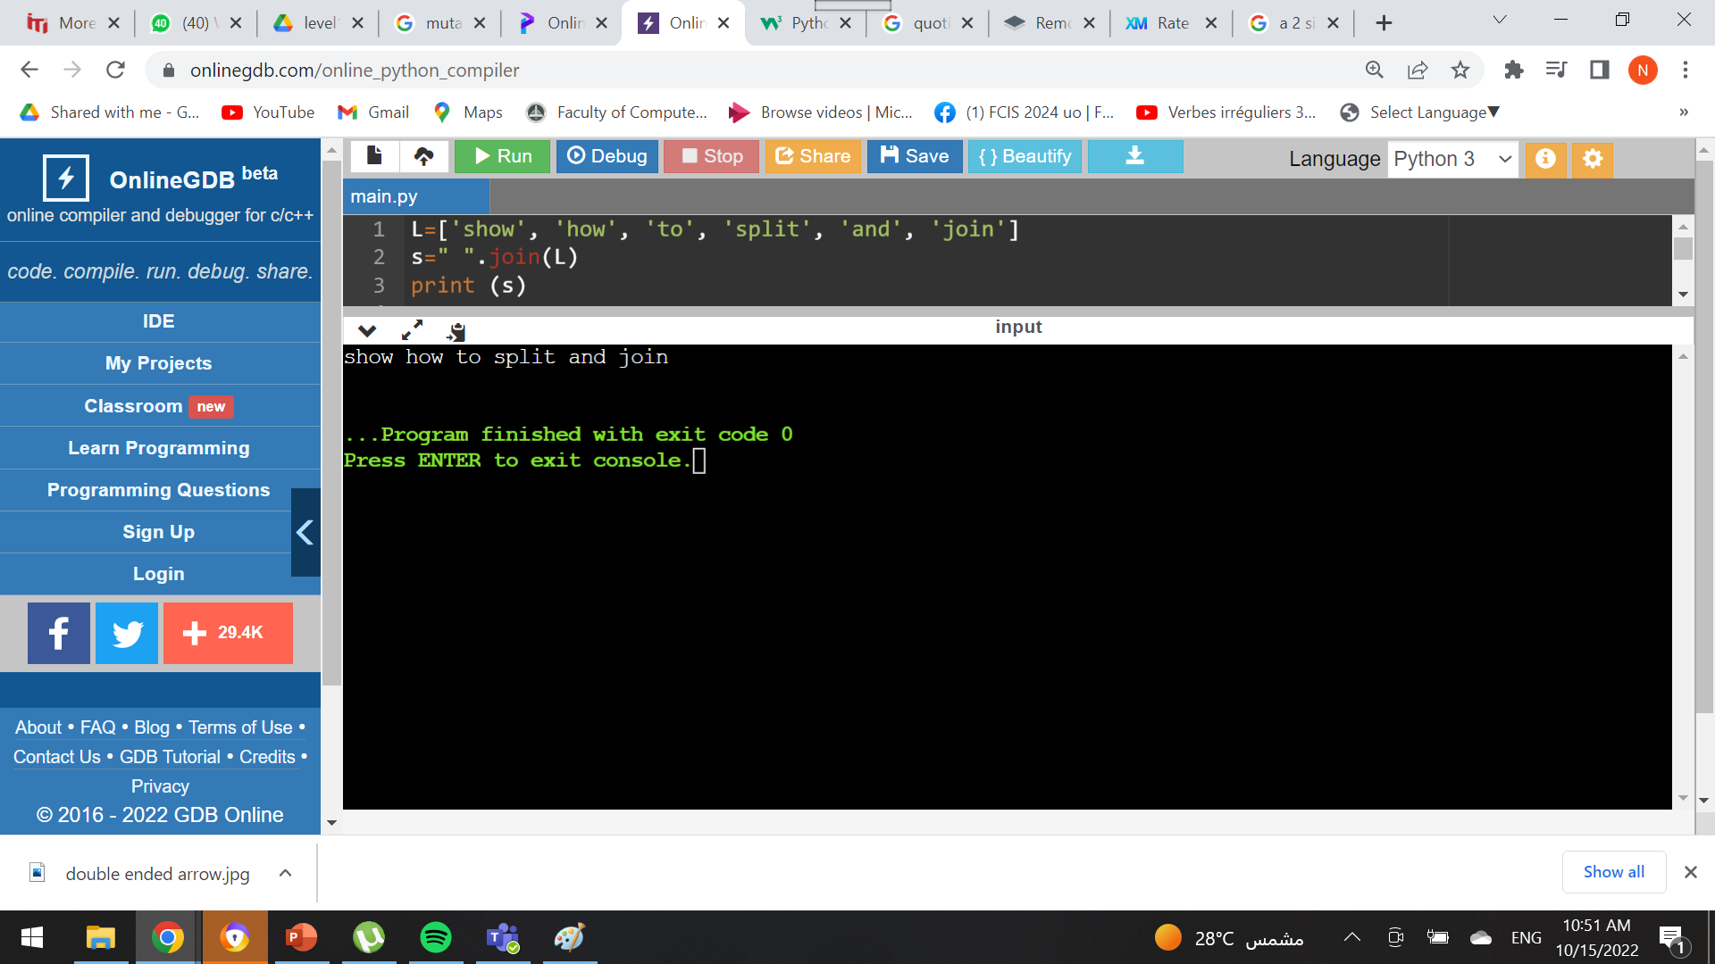
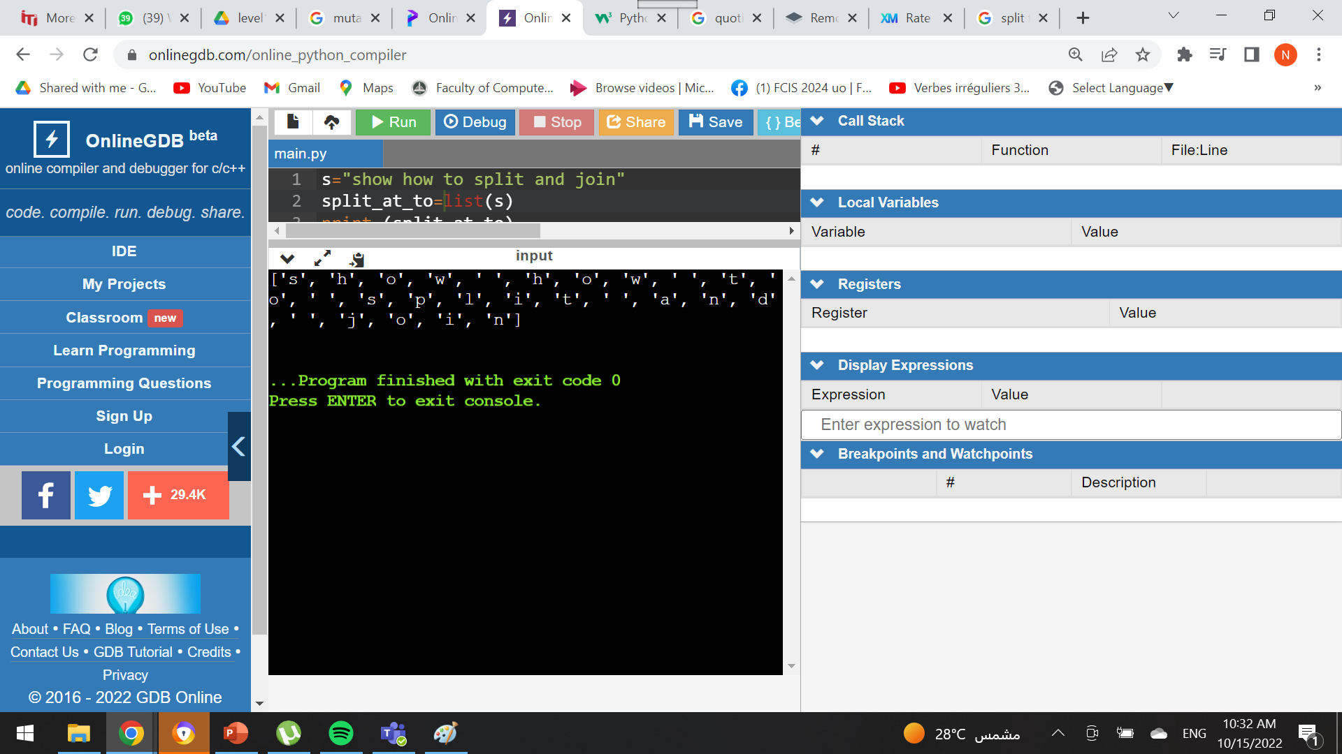
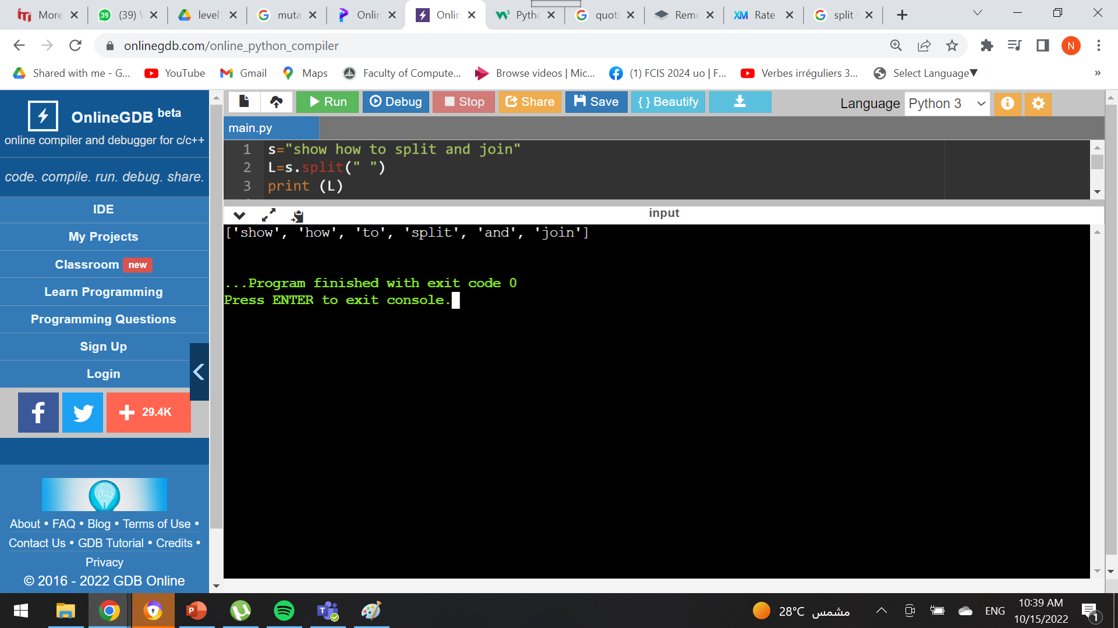
Strings & Lists
String
Lists
S = “show how to split and join” L = [‘show’, ‘how’, ‘to’, ‘split’, ‘and’, ‘join’]
String → List
S = “show how to split and join”
1)
Output:
2)
Output:
List → String
L = [‘show’, ‘how’, ‘to’, ‘split’, ‘and’, ‘join’]
1)
Output:

Slide 18
Assignment
DNA
RNA
RECV

Slide 19
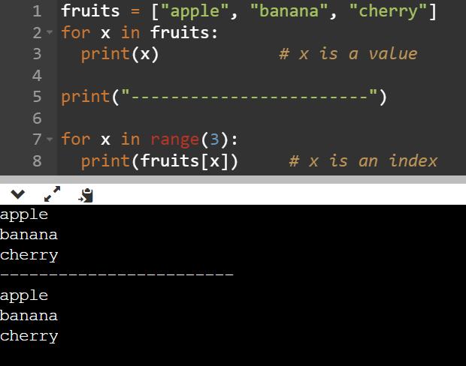
Q & A
What is the difference between …? Output

Slide 20
To be continued ….
Wednesday 26/10/2022

Slide 21
Thank you
Naryman Ahmed​
narymanahmed@gmail.com

